Slide 1



The Relationship Between Compound AI Systems and AI Agents
Compound AI Systems and AI Agents are two distinct yet complementary concepts in the field of artificial intelligence. While they share similarities, understanding their differences and interactions is crucial for advancing AI capabilities.
SA
by Shawaal Api

Slide 2

What are Compound AI Systems?
1
Integrated AI Components
2
Synergistic Capabilities
Compound AI Systems are composed of multiple AI agents or modules working together in an integrated system.
By combining the strengths of individual AI agents, Compound AI Systems can achieve more powerful and versatile capabilities.
3
Enhanced Decision-Making
The collaborative nature of Compound AI Systems allows for more robust and well-rounded decision-making processes.

Slide 3
What are AI Agents?
Autonomous AI Entities
Specialized Capabilities
Modular Approach
AI Agents are individual, self-contained artificial intelligence systems capable of independent decision-making and action.
AI Agents are often designed to excel at specific tasks or domains, leveraging their specialized knowledge and algorithms.
AI Agents can be combined or integrated to form more complex Compound AI Systems, contributing their unique capabilities.

Slide 4

Differences Between Compound AI Systems and AI Agents
1
Scope
Compound AI Systems have a broader, more comprehensive scope, while AI Agents focus on specific tasks or domains.
2
Complexity
Compound AI Systems exhibit a higher level of complexity, with multiple integrated AI agents working in coordination.
3
Adaptability
Compound AI Systems can adapt and evolve more easily by incorporating new AI agents or modifying existing ones.

Slide 5




Interactions Between Compound AI Systems and AI Agents
Integration
AI Agents can be seamlessly integrated into Compound AI Systems, contributing their specialized capabilities.
Collaboration
Compound AI Systems facilitate collaboration and information sharing among the constituent AI Agents.
Optimization
The Compound AI System can optimize the utilization of its AI Agents, enhancing overall performance.

Slide 6
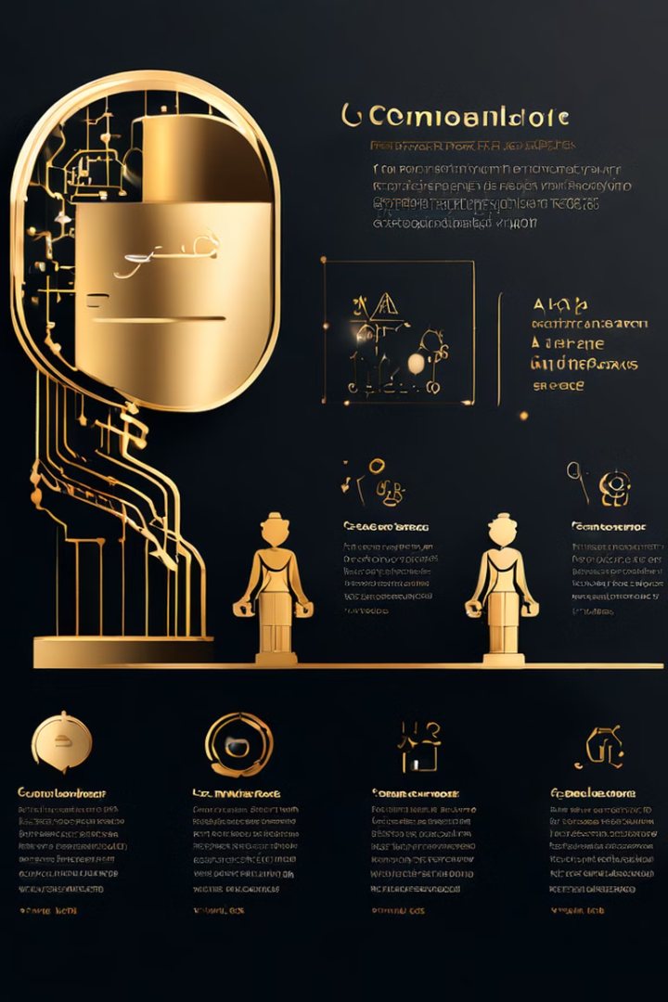
Advantages of Compound AI Systems
Versatility
Robustness
Compound AI Systems can tackle a broader range of tasks and problems by leveraging the diverse capabilities of their AI Agents.
The redundancy and complementarity of AI Agents within a Compound AI System can improve overall system resilience.
Scalability
Adaptability
Compound AI Systems can be easily scaled by adding or modifying AI Agents to meet evolving demands.
Compound AI Systems can dynamically adapt and learn, incorporating new AI Agents or updating existing ones.

Slide 7





Challenges in Developing Compound AI Systems
Coordination
Integration
Ensuring seamless coordination and communication among the AI Agents within a Compound AI System.
Developing effective mechanisms for integrating diverse AI Agents into a cohesive Compound AI System.
Scalability
Trust
Maintaining scalability and performance as the complexity and size of the Compound AI System grow.
Establishing trust in the decision-making and actions of a Compound AI System, especially in critical applications.

Slide 8

The Future of Compound AI Systems and AI Agents
Continued Advancement
Compound AI Systems are expected to become increasingly sophisticated, incorporating more advanced AI Agents and technologies.
Widespread Adoption
As the benefits of Compound AI Systems become more apparent, their adoption is likely to grow across various industries and applications.
Ethical Considerations
Ensuring the responsible development and deployment of Compound AI Systems, addressing concerns around safety, transparency, and accountability.
Societal Impact
The widespread use of Compound AI Systems may profoundly impact the way we live, work, and interact, reshaping numerous aspects of our society.

